Slide 1
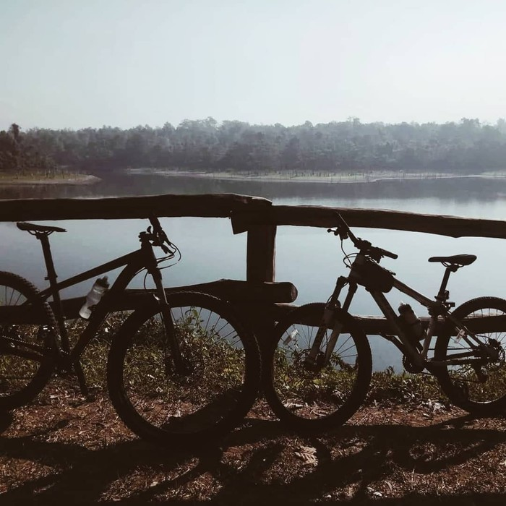
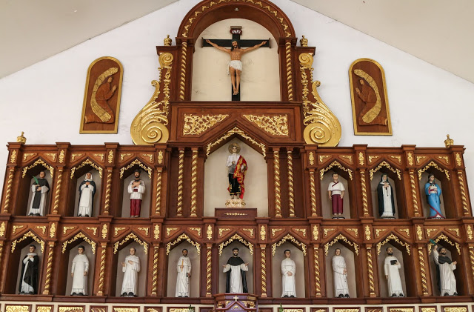
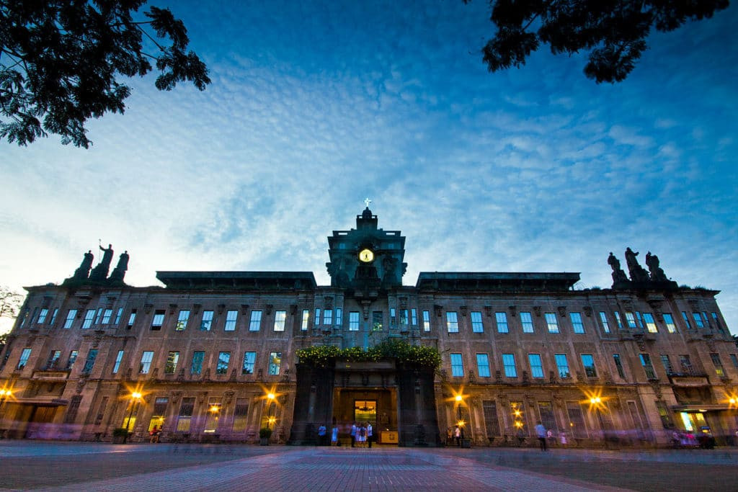
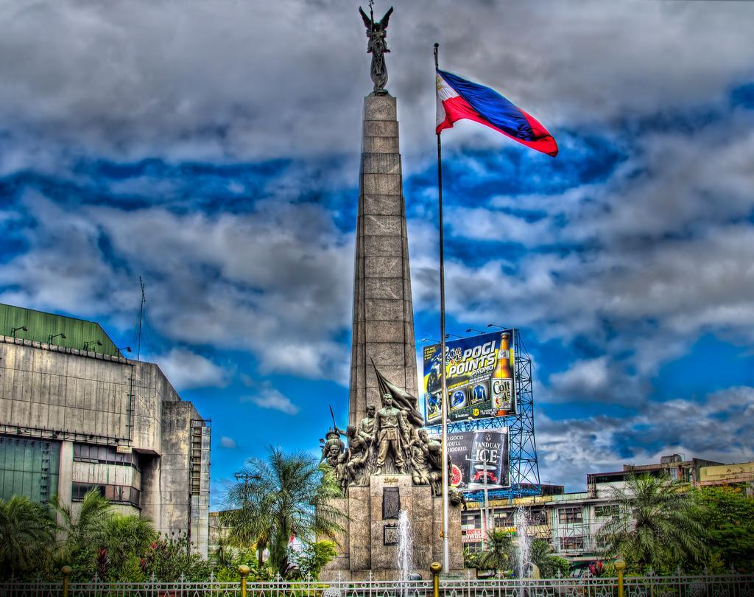
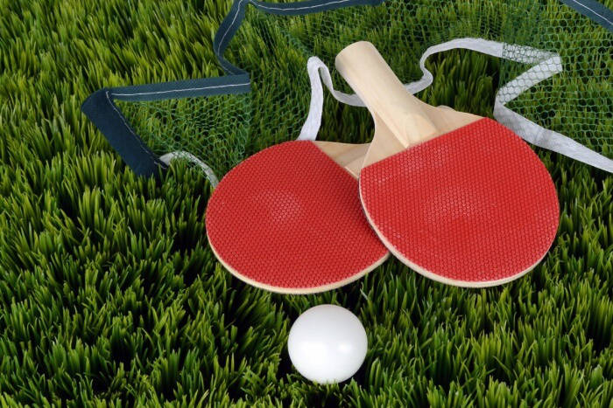
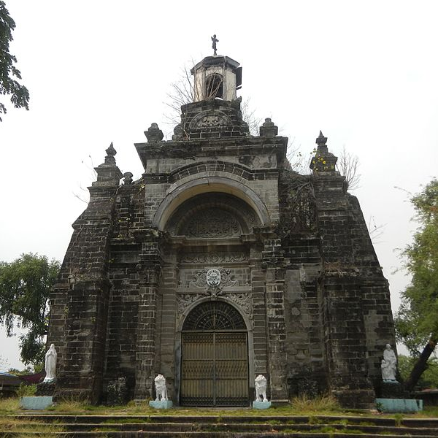
La Mesa Watershed
San Roque
University of Santo Tomas Museum
V I S I T
V I S I T
V I S I T
Bonifacio Circle
Monumento
Green Paddle
La Loma Cemetery
V I S I T
V I S I T
V I S I T

Slide 2
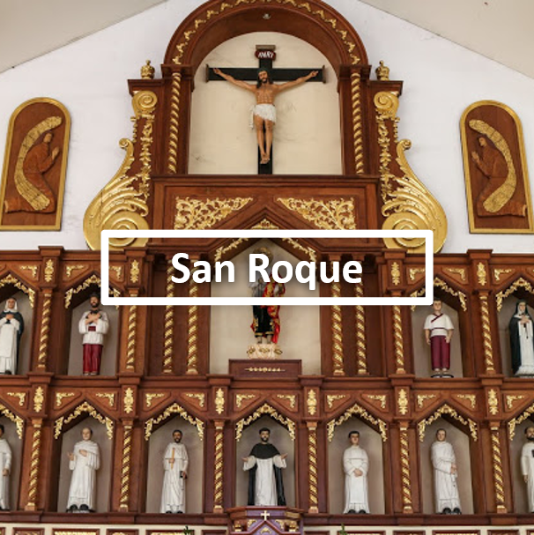
Visit the very first Catholic Church in Caloocan City. San Roque Cathdral has been blessed by Pope John Paul II, which is a huge deal in the Philippines! He apparently granted that the San Rouque Cathedral to attain the level & dignity of a Cathedral Church. As you can imagine, this has made San Roque Cathedral the pride and joy of Caloocan.
Sunday mass here is grand with locals piling into the pews for hours of worship. You don’t have to be Catholic to come and witness this principal practice in Philippine culture. The cathedral, itself, is a beautiful sight to be seen with a grand ceiling and intricate statues of Jesus on the cross. A visit here will make for quite the memorable experience.

Slide 3
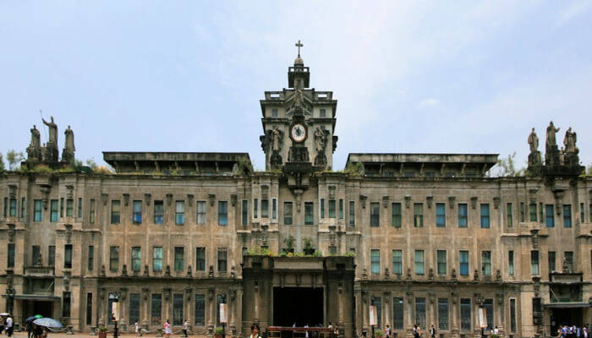
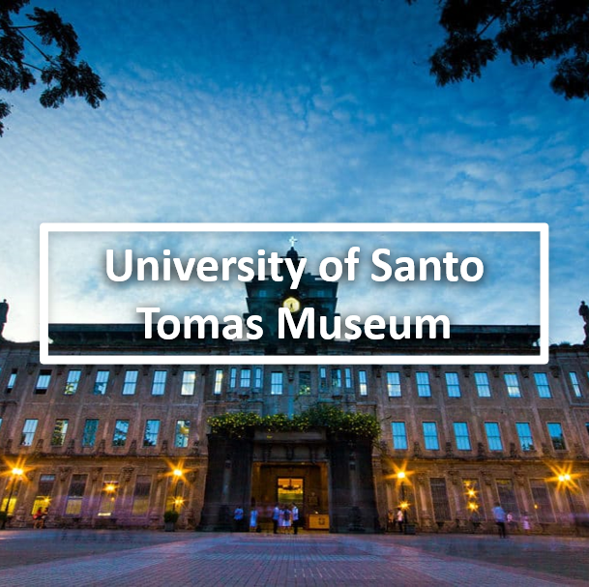
To promote Filipino culture and heritage, the University Of Santo Tomas Museum is open to the public. The pieces in this museum, not only serve to educate the public, but they also serve as learning tools for the University’s currently enrolled students.
The main exhibit, which the museum refers to as its “nucleus,” is the collection of gabinete de fisica. In laymen’s terms, this is a collection of natural specimen including plants, animals, minerals, and vegetables that are used by the students belonging to the pharmacy and medicine programs.
There are a variety of exhibits always on display and always changing. After the museum, have a walk around the exquisite campus.

Slide 4

Green paddle is a famous table tennis club of the city. If you want to brush up your skills or take them to the net level, then this is the place for you to come. Here you can personal training session with the experts of this field.
These coaches will guide you through the strategies with which you can master this game! There is also a sports store here where you can buy table tennis.

Slide 5
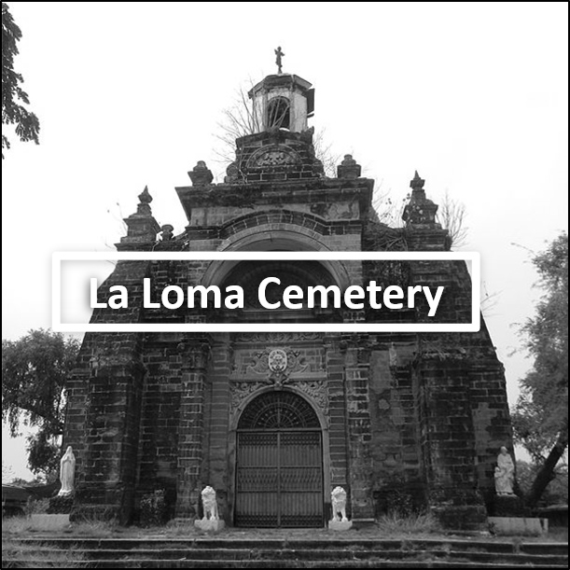
This plot of land was dedicated as a cemetery in 1884 and is now 130 acres of ancient tombstones. La Loma Cemetery has been a holy ground for catholic burials since the Spanish occupation.
While most of the city was destroyed or compromised during the Battle of Manilla in 1945, La Loma Cemetery was one of the few areas that escaped the warpath. This sets La Loma Cemetery apart from much of the city as it carries some of the oldest heritage and artifacts for native people in Caloocan.
Wander around the cemetery, respectfully reading the tombstones belonging to people born in the early 1800s. It’s spooky and fascinating at the same time.

Slide 6
Andres Bonifacio Monument is a mural commemorate to the lifework of Gat. Andres Bonifacio. It was created by Guillermo E. Tolentino, one of the National Artists of the Philippines. The construction of national monument for Andres Bonifacio was led by former Katipuneros, particularly Bonifacio’s friend and comrade, Guillermo Masangkay. On February 23, 1918, Act No. 2760 was passed by the Philippine Legislature approving the erection of a national monument in memory of Andres Bonifacio. Eight years later, on 29 August 1930, a jury created to select the best design for a monument to honor the Great Plebeian convened. It was headed by Architect Andres Luna de San Pedro and was composed of sculptor Vicente Francisco and Architect Tomas Mapua. Painter and Director of the UP College of Fine Arts Fabian dela Rosa was supposed to preside in the deliberation but later declined to ensure fairness when he learned that one of his colleagues from his college was one of the competitors.
The chosen design was National Artist Guillermo Tolentino's design which consists of a 45-foot pylon topped by the winged figure of victory. At its base is a platform-like structure with figures symbolized the Philippine Revolution. The pylon is composed of five parts which correspond to the five aspects of the Katipunan-Kataastaasan, Kagalanggalang na Katipunan ng mga Anak ng Bayan (KKK). The monument stands on a base in the shape of an octagon whose eight sides symbolize the first eight provinces placed under martial law for revolting against Spain and the eight rays in the Philippine flag. There are three steps leading to the monument, representing the three centuries of Spanish rule.

Slide 7
Museo ng Valenzuela is one of the city’s main historical and cultural landmarks, and houses a vast collection of artifacts and memorabilia that traces Valenzuela’s rich history and immense progress. The sprawling Museo, with its impressive architecture and preserved Spanish aesthetics, is a shining symbol of Valenzuela’s heritage, and is likewise a choice venue for cultural and artistic events, as well as public seminars and conventions.

Slide 8
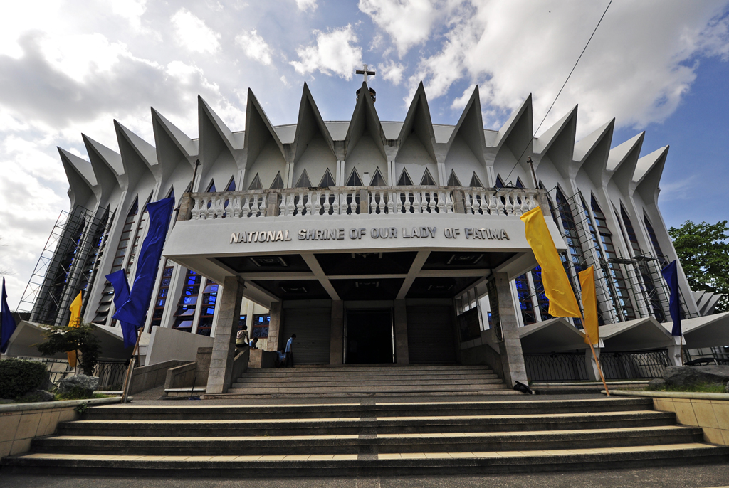
Located near the Our Lady of Fatima University, this shrine is the center of the Philippine Fatima apostolate. It was declared a tourist site in 1982 by the Department of Tourism, and most recently, it was declared a pilgrimage site by the Diocese of Malolos.
The National Shrine and Parish of Our Lady of Fatima is a parish church and national shrine in the Diocese of Malolos in the Philippines. It serves as a Philippine apostolate of Our Lady of Fatima in Fátima, Portugal, which is recognized by the Roman Catholic Church in the Philippines. The shrine is located near the Our Lady of Fatima University campus in Marulas, Valenzuela City in Metro Manila, Philippines.The shrine is one of the three major pilgrimage sites in the Diocese of Malolos, with the National Shrine of St. Anne in Hagonoy and the National Shrine of Divine Mercy in Marilao as the other sites.

Slide 9
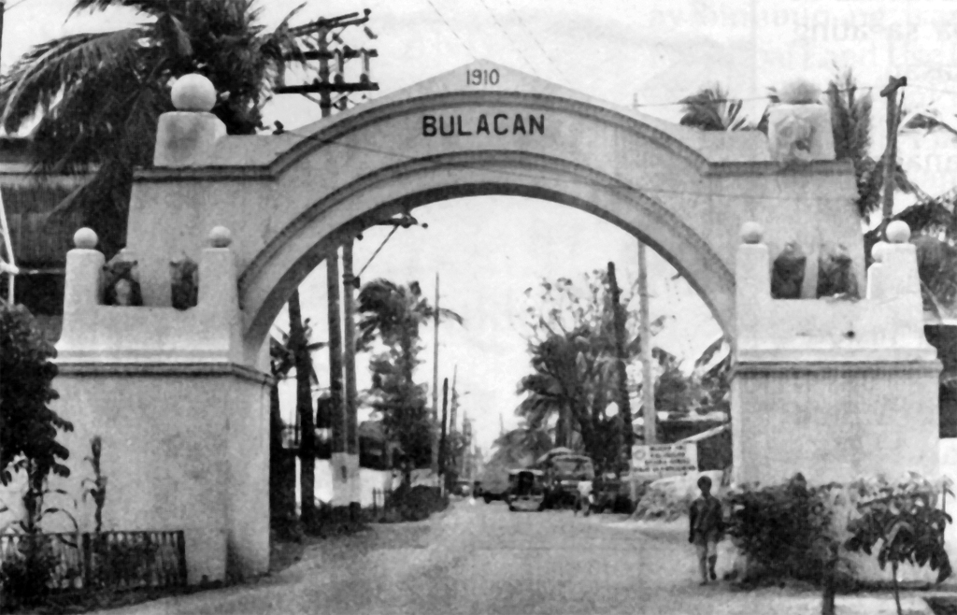
This stone arc, found along M.H. Del Pilar Street, was built by the Americans in 1910, and served as the boundary between Rizal and Bulacan province. Before the existence of MacArthur Highway and NLEX, Valenzuela was already the gateway to the north, albeit with M.H. Del Pilar being the main road to Northern Luzon. Today, the Arkong Bato marks the boundary between Barangay Santulan in Malabon and the arch’s namesake, Barangay Arkong Bato in Valenzuela.

Slide 10
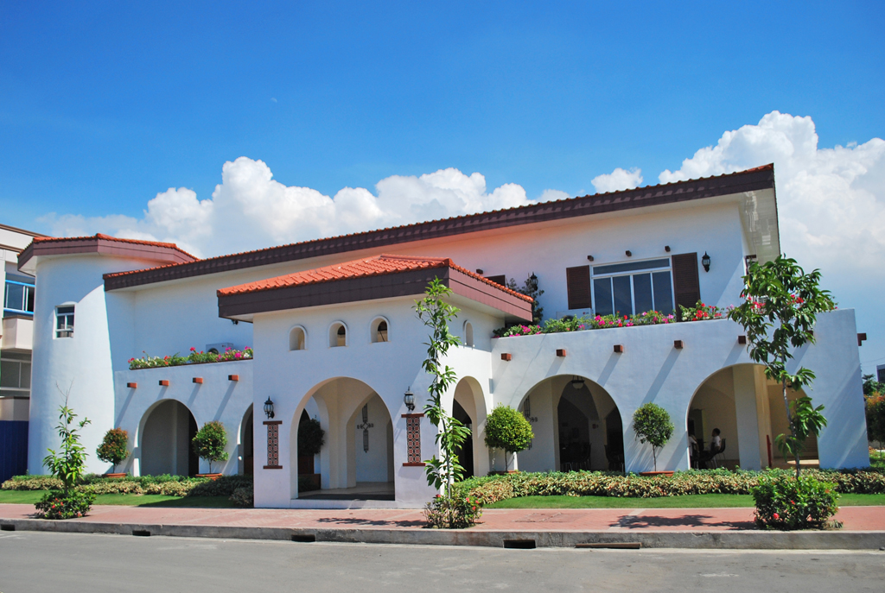
Located within the premises of Valenzuela City Hall, the Mediterranean-inspired Social Hall is one of Mayor Win’s pet projects, and features pristine white walls and stone arches, high ceilings, and lush greens. The Social Hall serves as the canteen for City Hall’s many employees, as well as a relaxed environment for meetings and social gatherings.

Slide 11
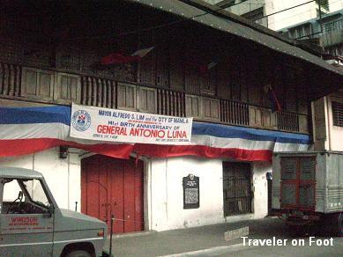
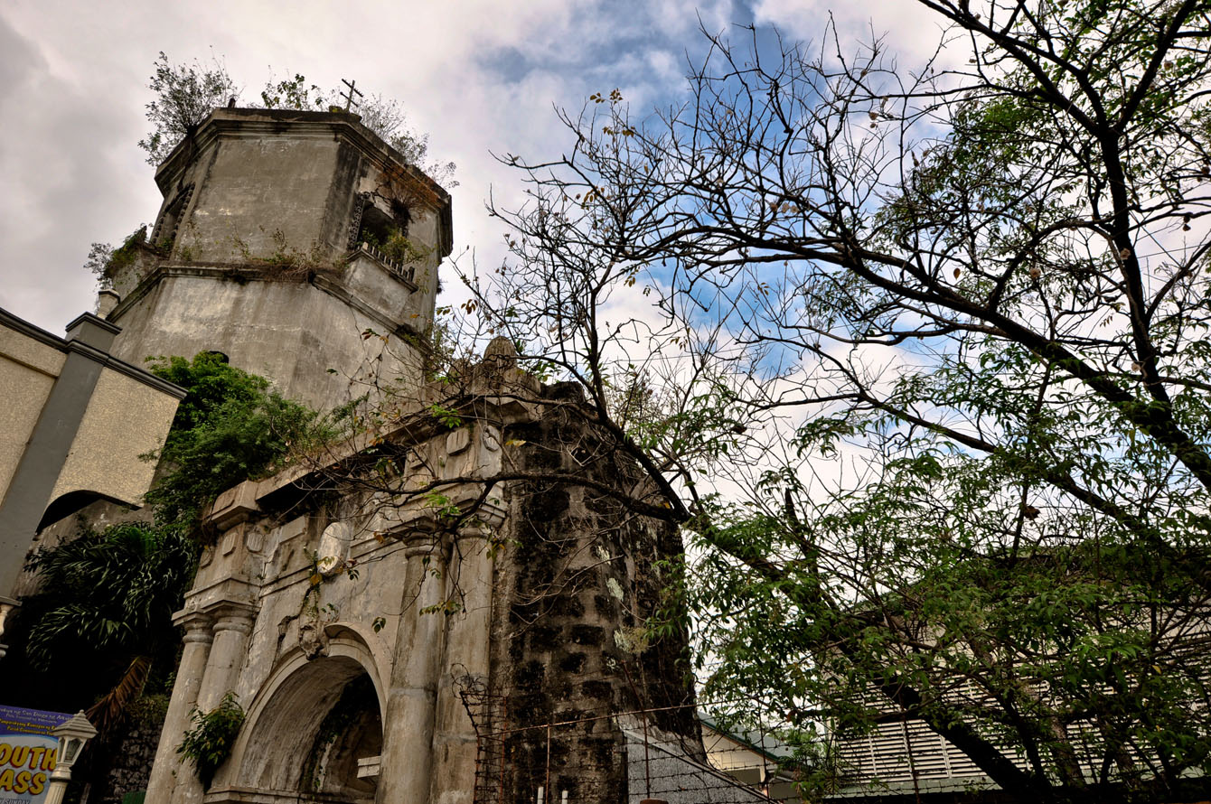
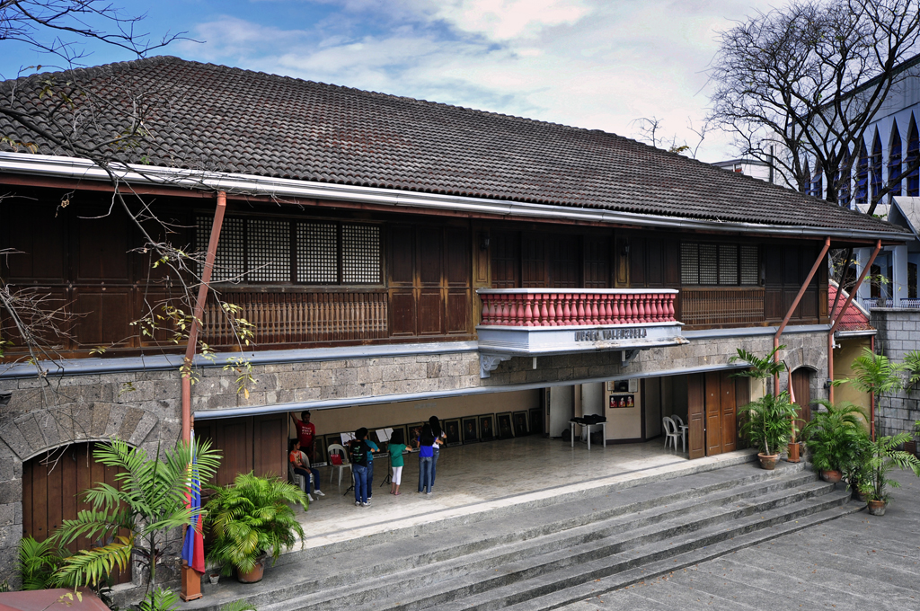
House of Dr. Pio Valenzuela
Bell Tower
Museo ng Valenzuela
V I S I T
V I S I T
V I S I T
National Shrine of Our Lady of Fatima
Arkong Bato
Valenzuela City Social Hall
V I S I T
V I S I T
V I S I T
House of Dr. Pio Valenzuela

Slide 12
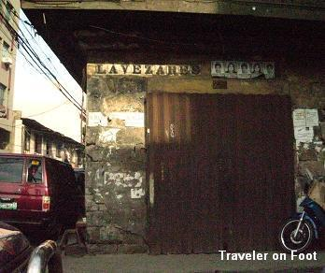
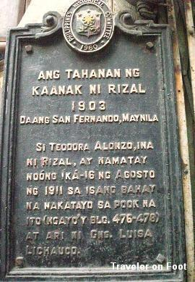

Slide 13
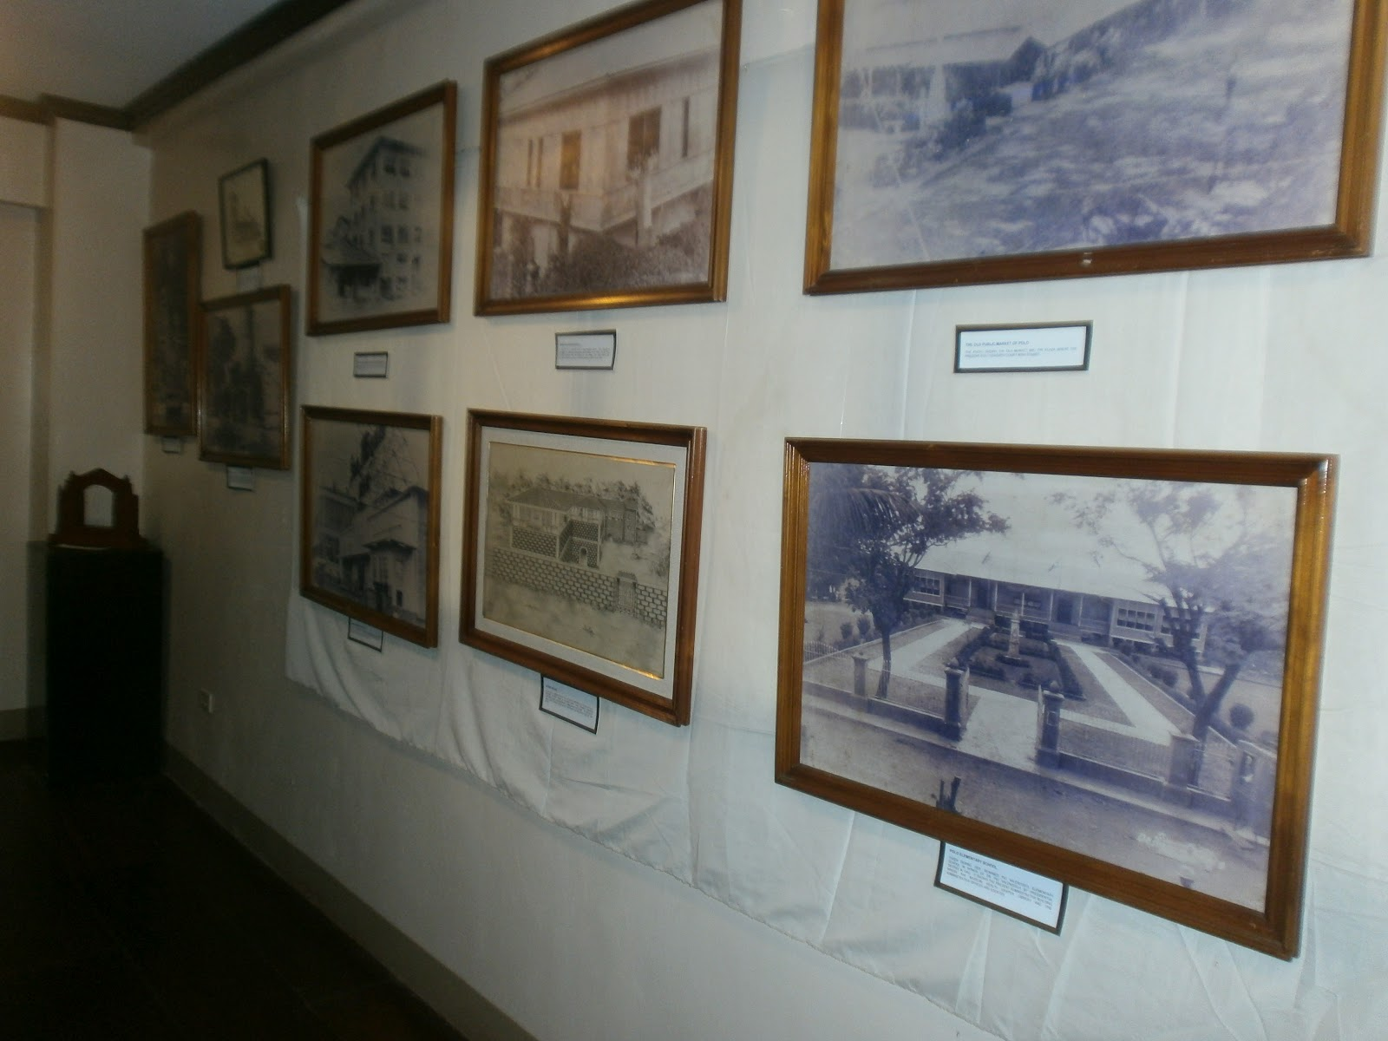
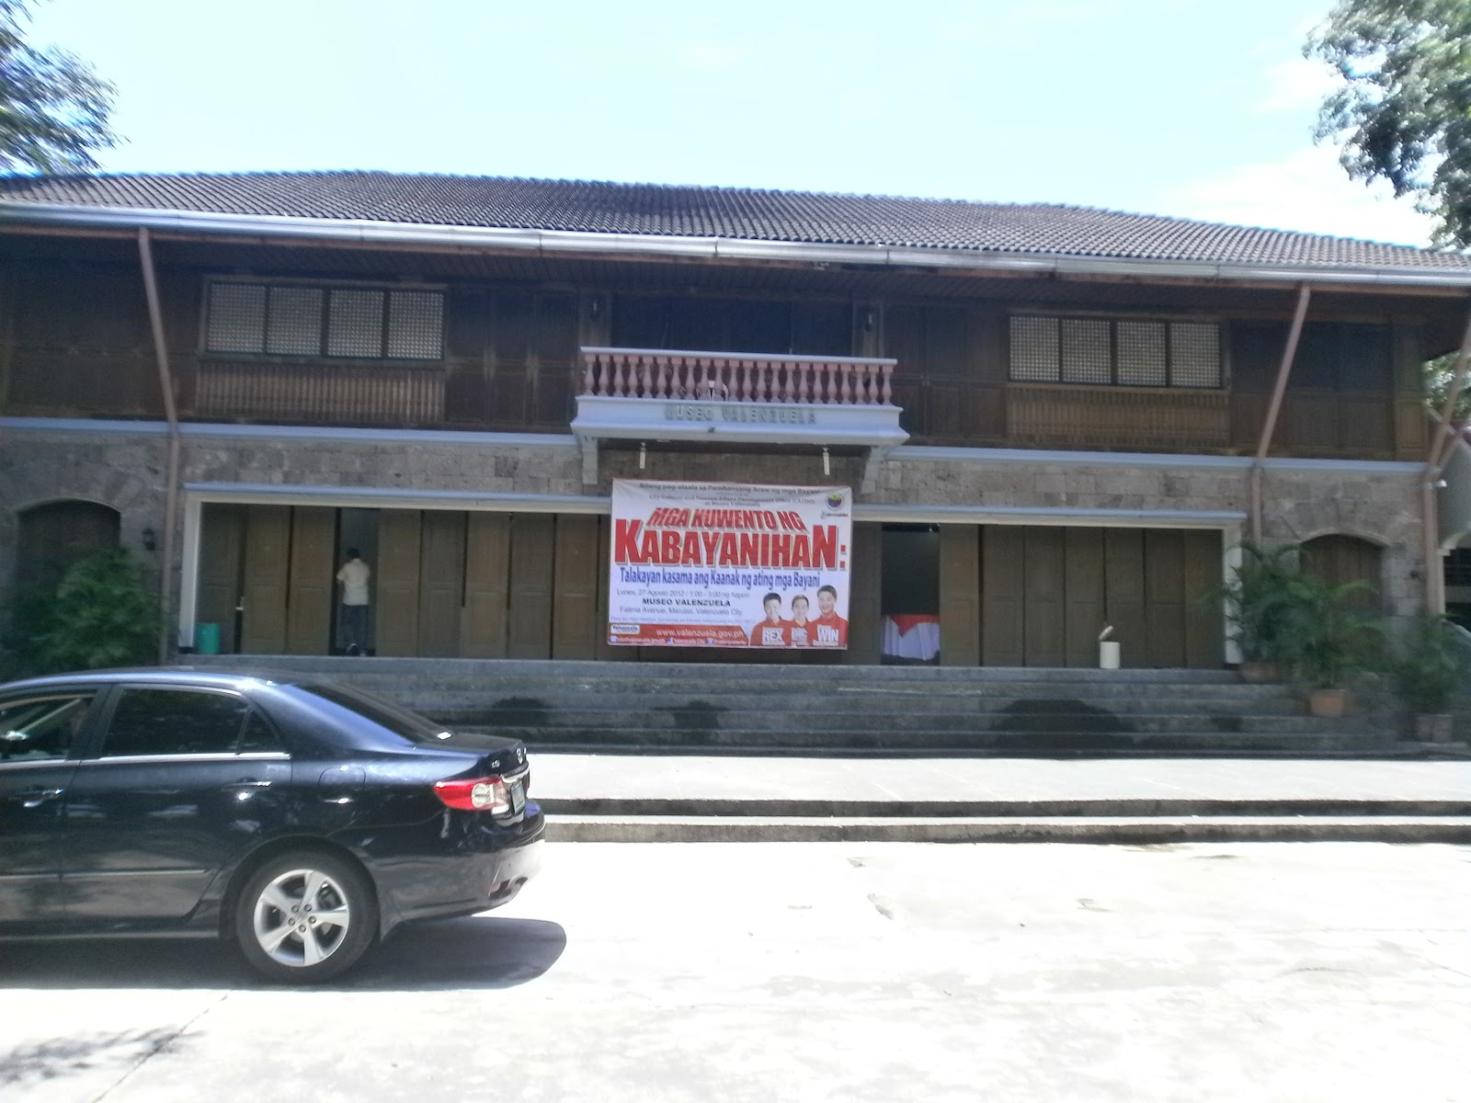
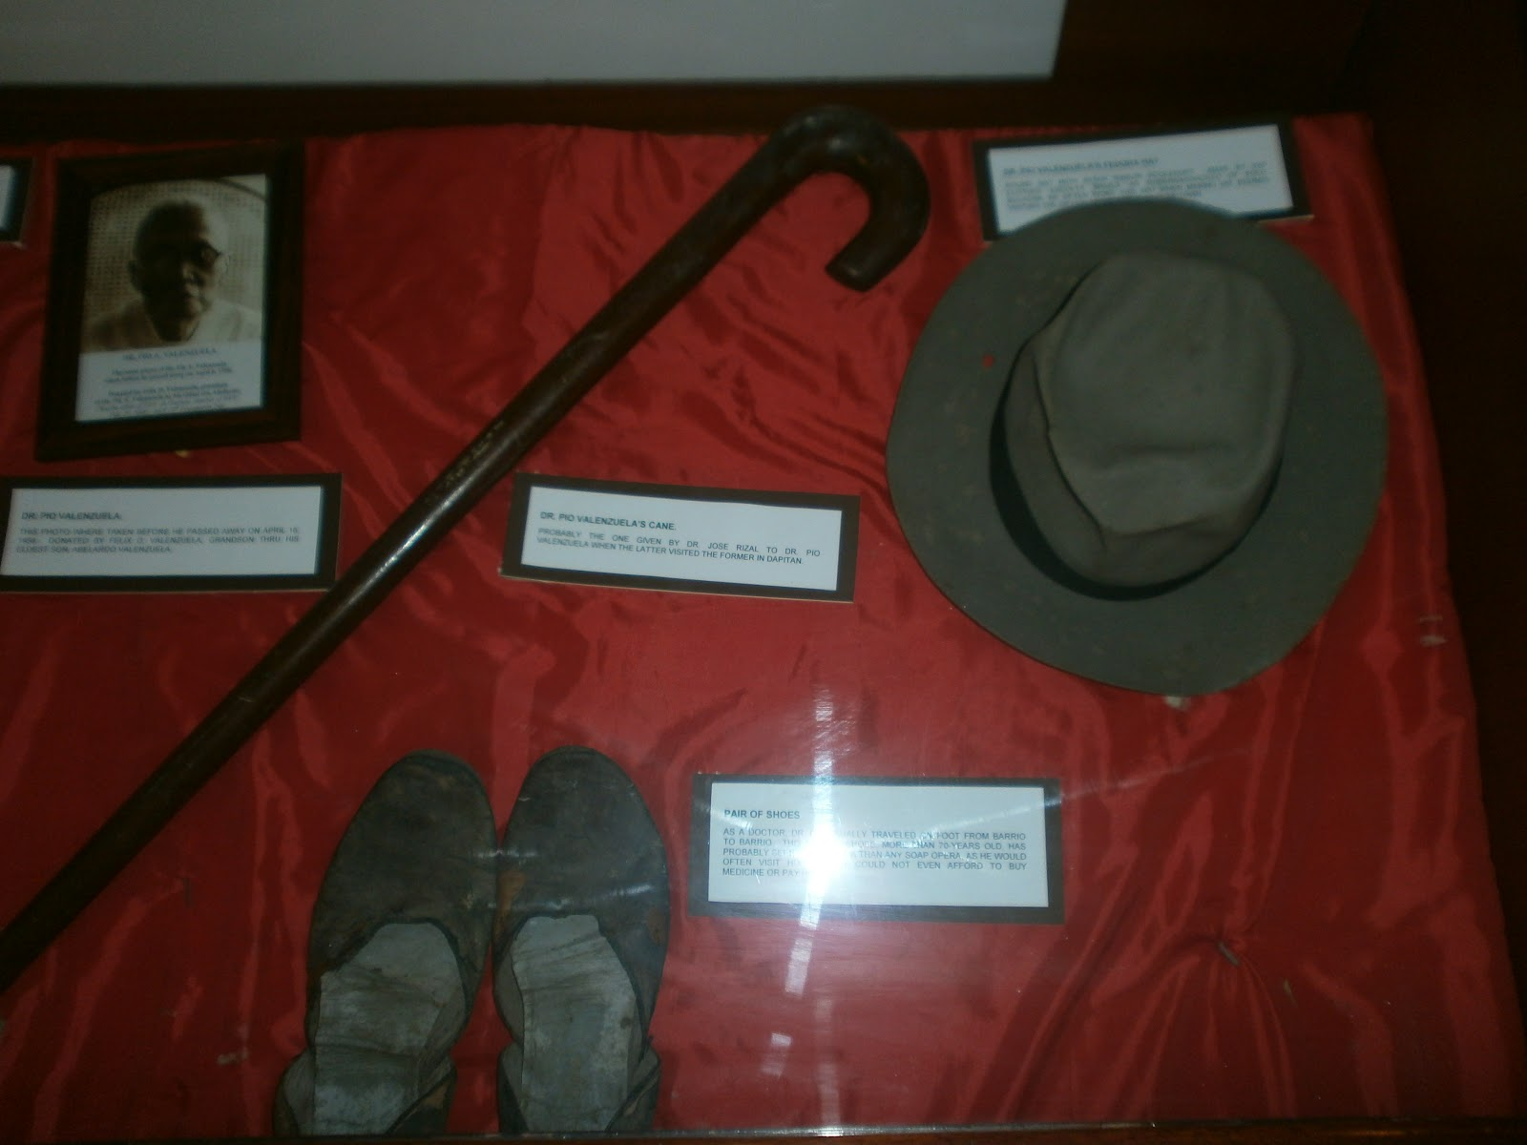

Slide 14
Dr. Pio Valenzuela, the revered member of the Katipunan's triumvirate and our city's namesake, was born in this house on July 11, 1869. Found along Velilla Street in Barangay Pariancillo Villa, this house has become a tourist attraction, and more importantly, a valuable part of the city's heritage.
The house of Dr. Pio Valenzuela, a member of the Supreme Council of the Katipunan once stood along Calle Lavezares, held his medical practice here offered free to the poor. A historic maker was placed near the site that indicates the Valenzuela house to be once the secret printing office the revolutionary paper "Ang Kalayaan."
The Katipunan mislead the Spanish authorities by indicating the the Kalayaan is edited by Marcelo H. del Pilar and that Yokohama, Japan as the place of publication. But in truth, it was Emilio Jacinto who served as its editor. The maiden issue was relased in March of 1896 with detialed incidences of abuse by friars and civil employees. Copies were distributed in Manila and the provinces. However, due to lack of supplies, printing types were stolen by Katipuneros working for Diario de Manila. This incident led to the discovery by the Spanish authorities of the Kalayaan.
The house also provided temporary protection to Andres Bonifacio's widow Gregoria de Jesus and their son. It was also in this house where Bonifacio's infant son passed away to an illness.

Slide 15
The original church was the oldest church in the city, built by Father Juan Taranco and finished by Father Jose Valencia in 1632. Destroyed during World War II, its surviving belfry is the oldest in the city.
The Church of San Diego de Alcala in Brgy. Polo in Valenzuela was completed in 1632. Residents were forced into labor to complete the church after the town gained its independence in 1623 from Catangalan through the efforts of Father Juan Taranco and Don Juan Monsod, the barangay head of Polo. The main structure was destroyed by bombs during the Japanese occupation of the Philippines in World War II. The belfry and entrance are the only parts of the four-century old edifice that remain today. They have been preserved by the citizens of Polo (now Valenzuela, Metro Manila).
The belfry or bell tower of San Diego de Alcala Church is a cultural and religious relic of the bygone Spanish era. A new church has since been rebuilt and renovated adjacent to the ruins, serving as an aesthetic counterpoint to the largely unchanged tower.

Slide 16
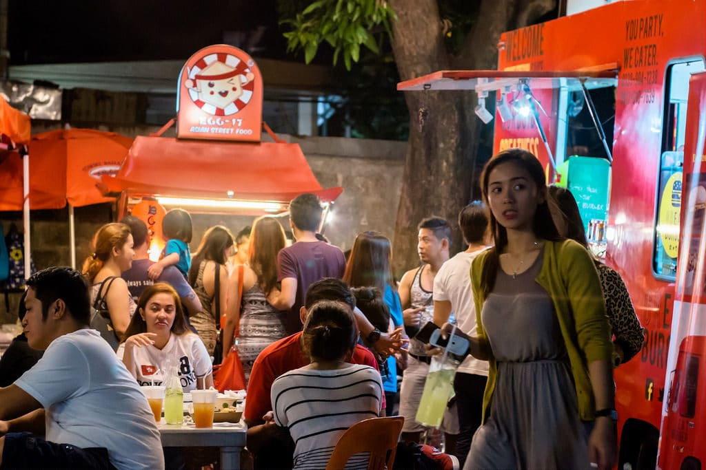
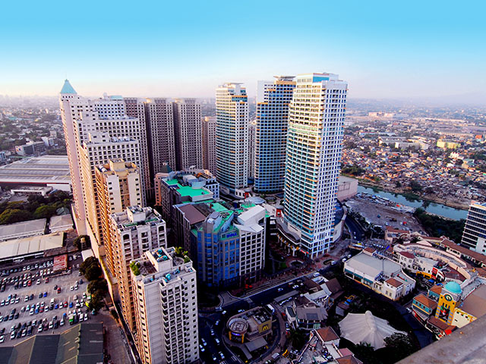
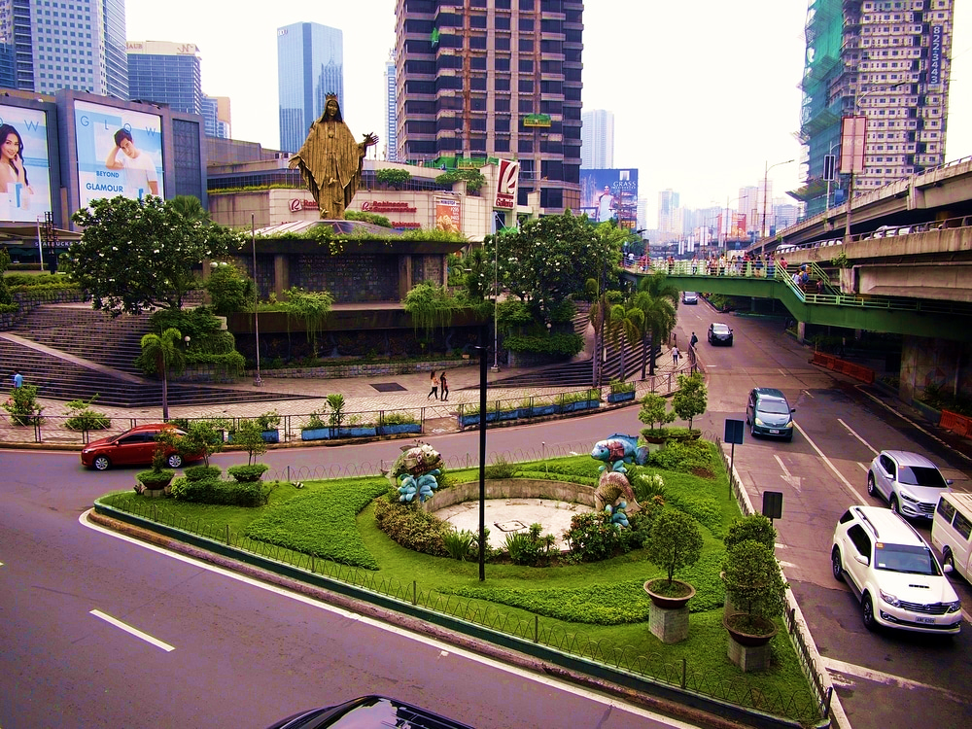
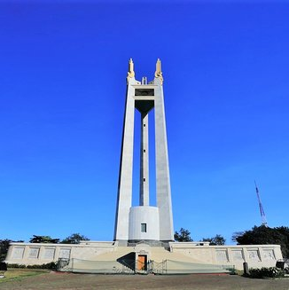
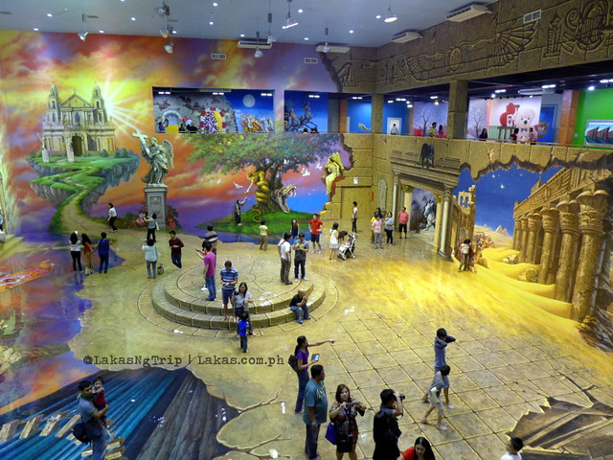
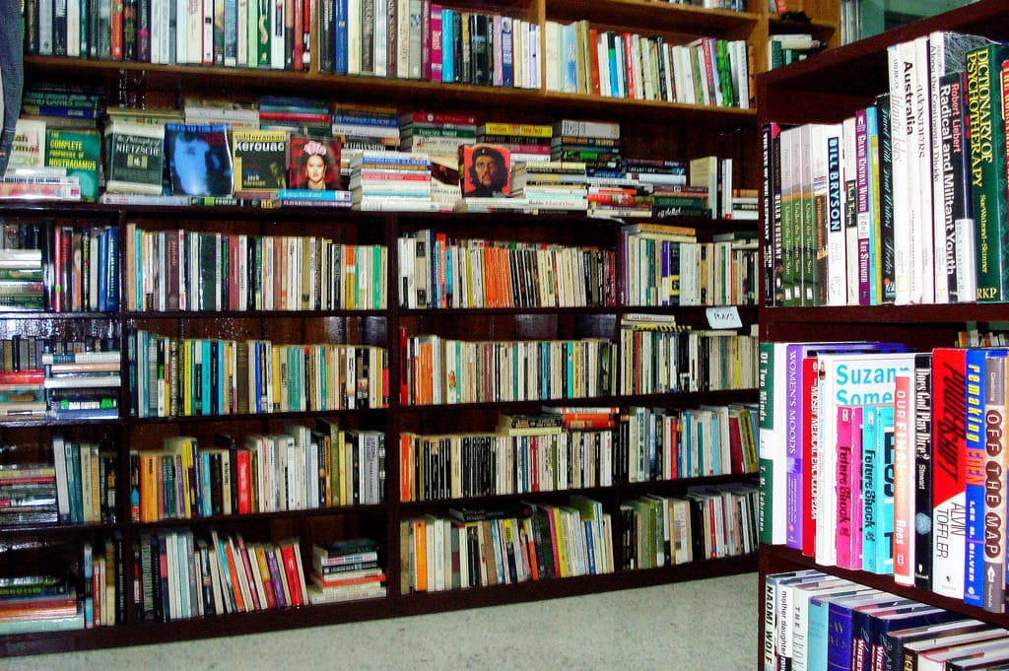
Maginhawa Food Park
Eastwood City
EDSA Shrine
V I S I T
V I S I T
V I S I T
Quezon Memorial Circle
Art in Island
Bookay - Ukay
V I S I T
V I S I T
V I S I T

Slide 17
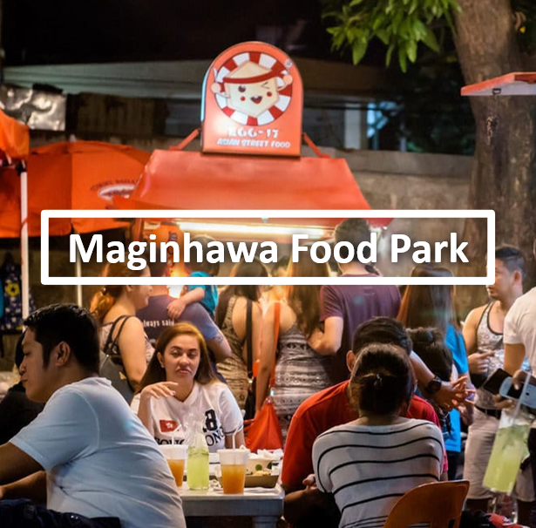
Maginhawa Street in Quezon City is one of the top go-to places for a food trip around the metro. However, the turnover rate in the area has become really high lately. I’m having a hard time keeping this list updated every time a new restaurant opens or closes in the area. To make my life easier, I’ve decided to just narrow down this list to 10 places to eat in the Maginhawa area (which are still open as of January 2019).
These are the tried-and-tested restaurants in the Maginhawa area (including Malingap street and nearby side-streets) which I personally recommend and frequent a lot. I picked these places because of the quality of their food and not just their “Instagram-worthiness” or novelty/gimmicky factor. Frankly, I think the over-saturation of restaurants in the area, particularly the food parks (there are just too many) caused many smaller businesses to close down. Anyway, here are my favorites.

Slide 18
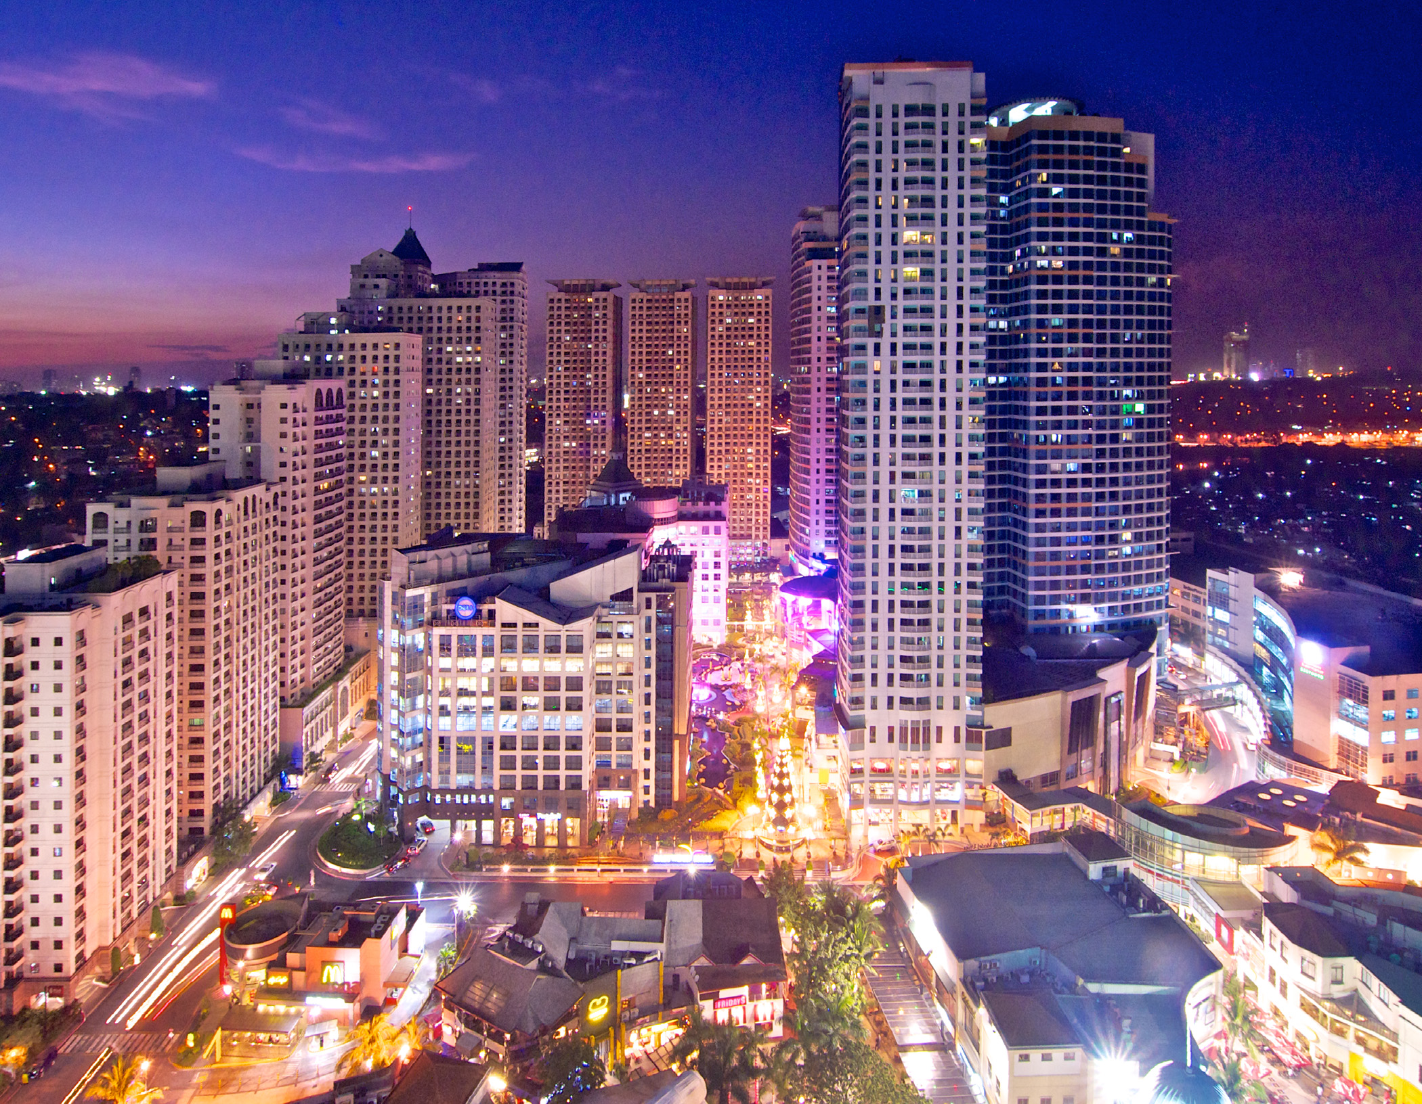
Eastwood City is the Philippines’ very first “live-work-play” community, which offers residents and visitors a total experience – entertainment, shopping, dining, and other exciting attractions.
EPHI is a company under Megaworld Corporation, considered the number one residential condominium developer and BPO office space provider and landlord in the country today.
Go shopping in luxurious high-end stores or go the craft route with trinkets at the local flea market. Eat local or western with both upscale restaurants and hole in the wall stalls. Veg out at the Movie House, sit down and have a drink at one of the trendy bars or enjoy the outdoors in the courtyard surrounded by palm trees when you’re looking for entertainment.

Slide 19
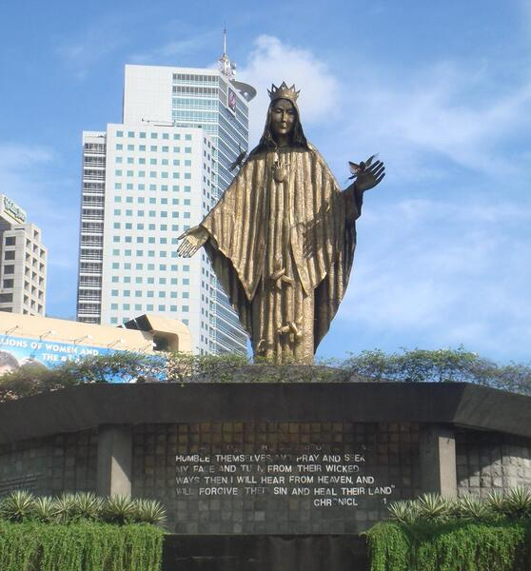
Sitting at the corner of EDSA and Ortigas Avenue, the Shrine of Mary, Queen of Peace or commonly known as the EDSA Shrine, has just been recognized by the National Commission for Culture and the Arts (NCCA) as an “important cultural property.” This simply means that the shrine will be able to receive government funding for its conservation and restoration.
The declaration reads, “The church is uniquely designed in terms of function and form which can be easily be distinguished as Mañosa’s work. It represents a modern take on Filipino architecture and adaptation of tropical architecture.”
The shrine is notably recognized for its bronze statue of Our Lady of Queen of Peace, which was designed by artist Virginia Ty-Navarro. In the same article by Denise Mañosa, she also noted that consultants once predicted for the statue of the Blessed Virgin to break once a typhoon hit it. But since its completion, the image never shattered once.

Slide 20
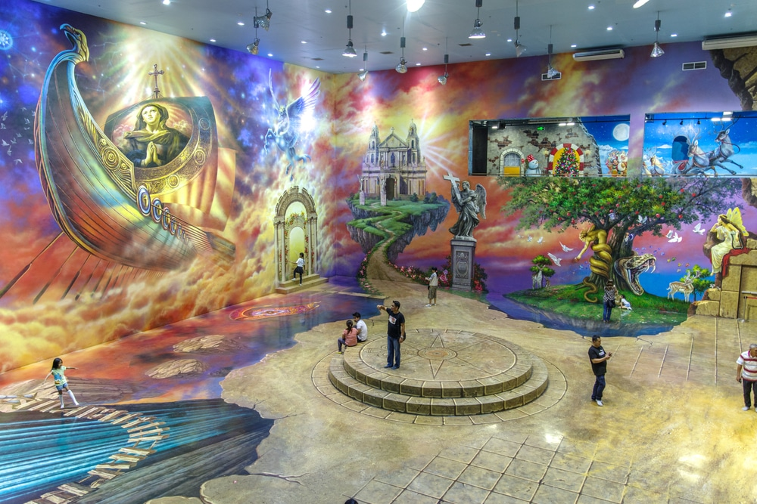
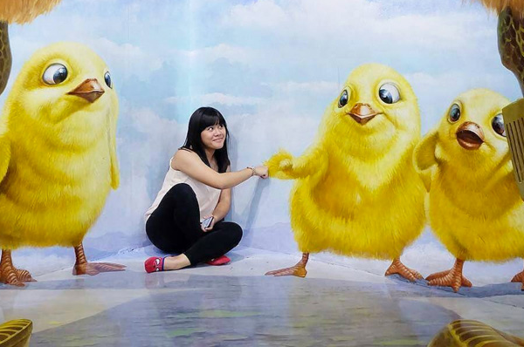
This unique destination located in the hipster neighborhood of Cubao Expo has been dubbed as the world’s first selfie museum. The beautiful 3D paintings encourage guests to take selfies with themselves as the center piece.
Art In Island is a 3D interactive art museum and one of the biggest of its kind here in the Philippines and in the world! We invite everyone to "BE PART OF ART" by being creative with your poses and taking pictures as much as you want!
You’ve seen those Facebook photos of people posing with life-size art pieces that seem to transport them into the photo, right? Well, now it’s your turn.
At Art in Island in Quezon, you can help make each piece of art come to life with you as the star. These 3D paintings and photos swallow you whole and trick the camera into thinking that you are really riding a wild chariot of wild horses, that you are part of Santa’s reindeer troop, that you’re riding on Aladdin’s magic carpet, or that you are about to get your head bitten off my a ferocious lion.

Slide 21
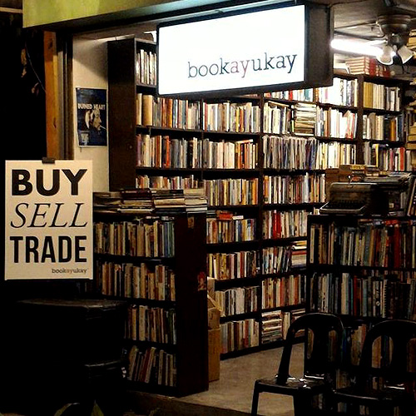
Bookay - Ukay
This bookstore feels like a Disney movie has come to life. With towering shelves stacked full of every book imaginable, you can rummage to your heart’s desire.
Book worms will appreciate that Bookay-Ukay is open late into the night for when you need that poetry fix or if you are wandering around the city looking to learn a bit more about Quezon’s roots.
Specializing in pre-loved books, just about every genre represented here. Feel free to sit in a cozy corner to do your reading here.
Bookay-Ukay is a “buy, sell, trade” bookstore that is perfect for travelers who want to turn in a finished book for another great read. If you don’t have a book to trade, that’s okay as prices are super affordable.

Slide 22
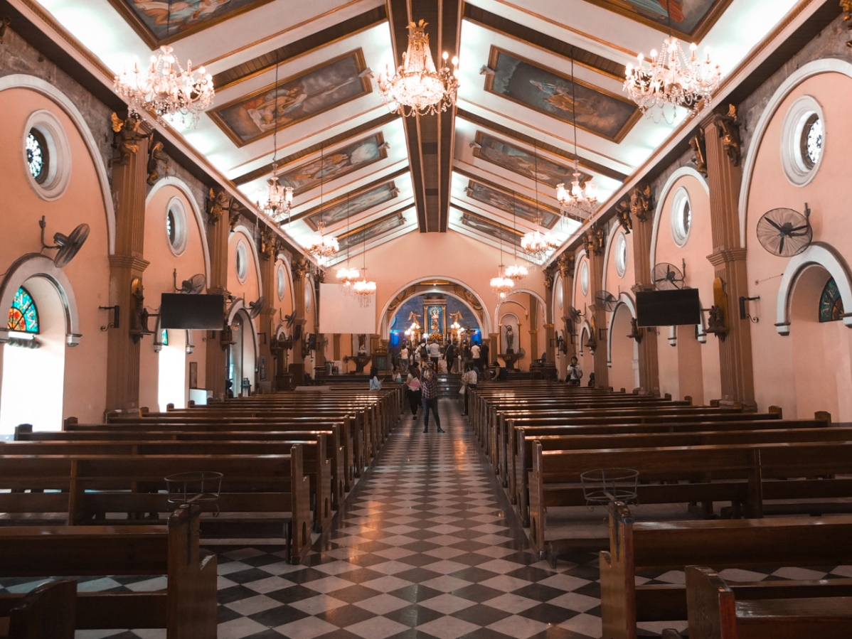
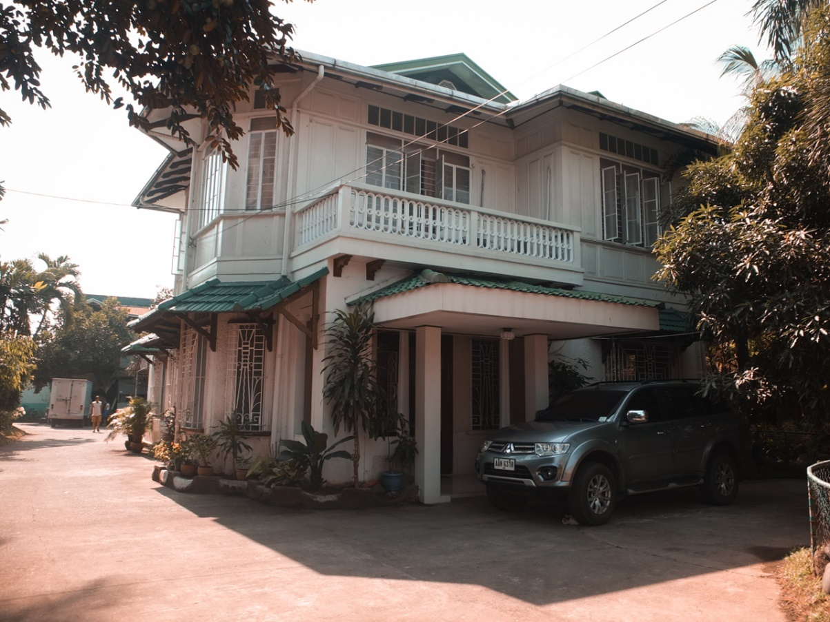
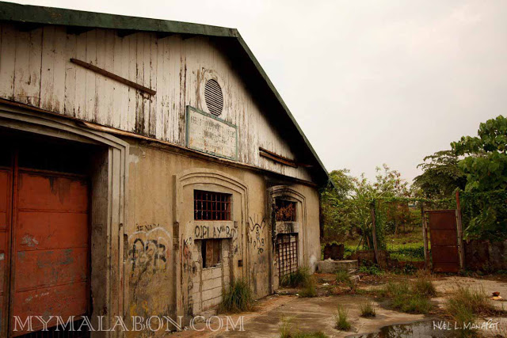
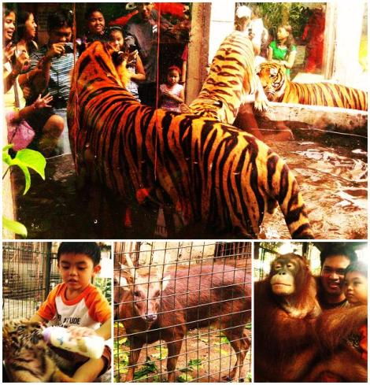
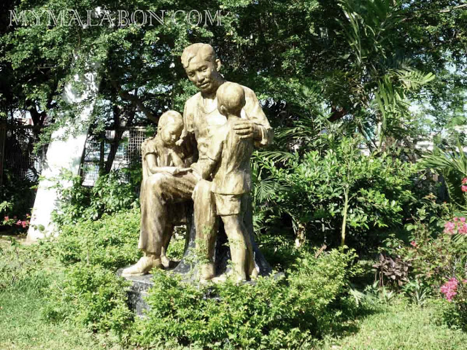
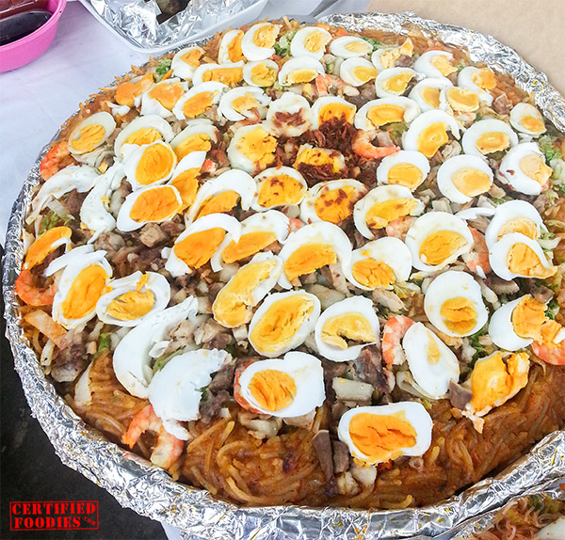
Immaculada Conception De Malabon
Patis Factory
Asilo De Huertanos
V I S I T
V I S I T
V I S I T
Malabon Zoo
Rizal Shrine
Pancit Malabon
V I S I T
V I S I T
V I S I T

Slide 23
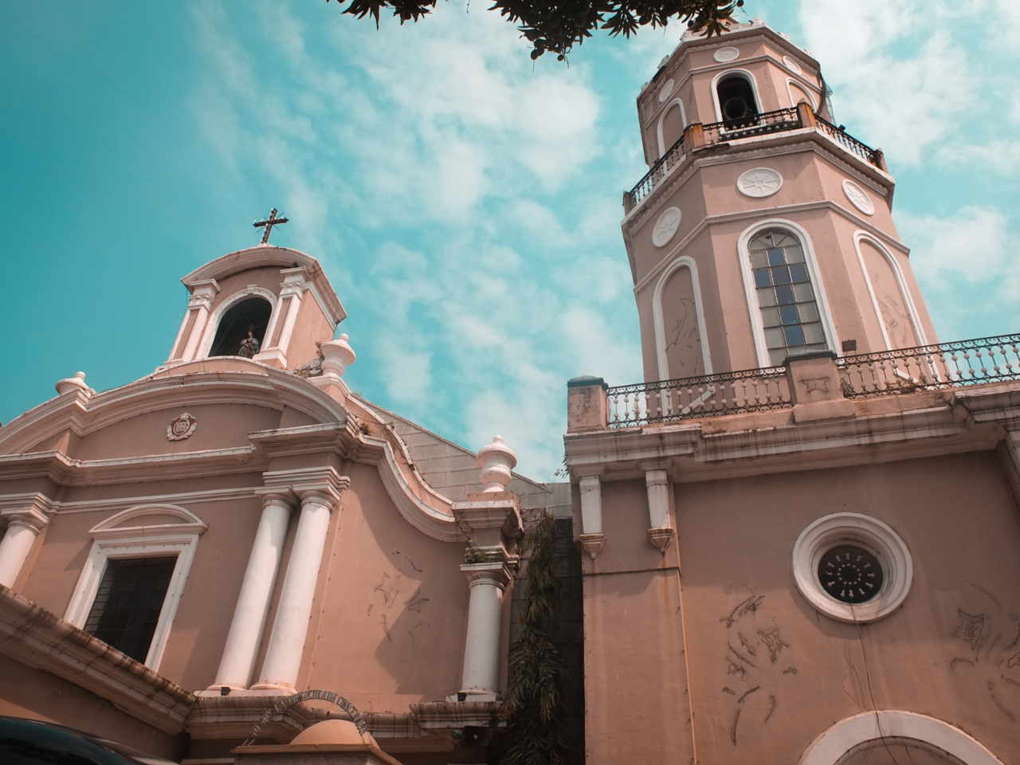
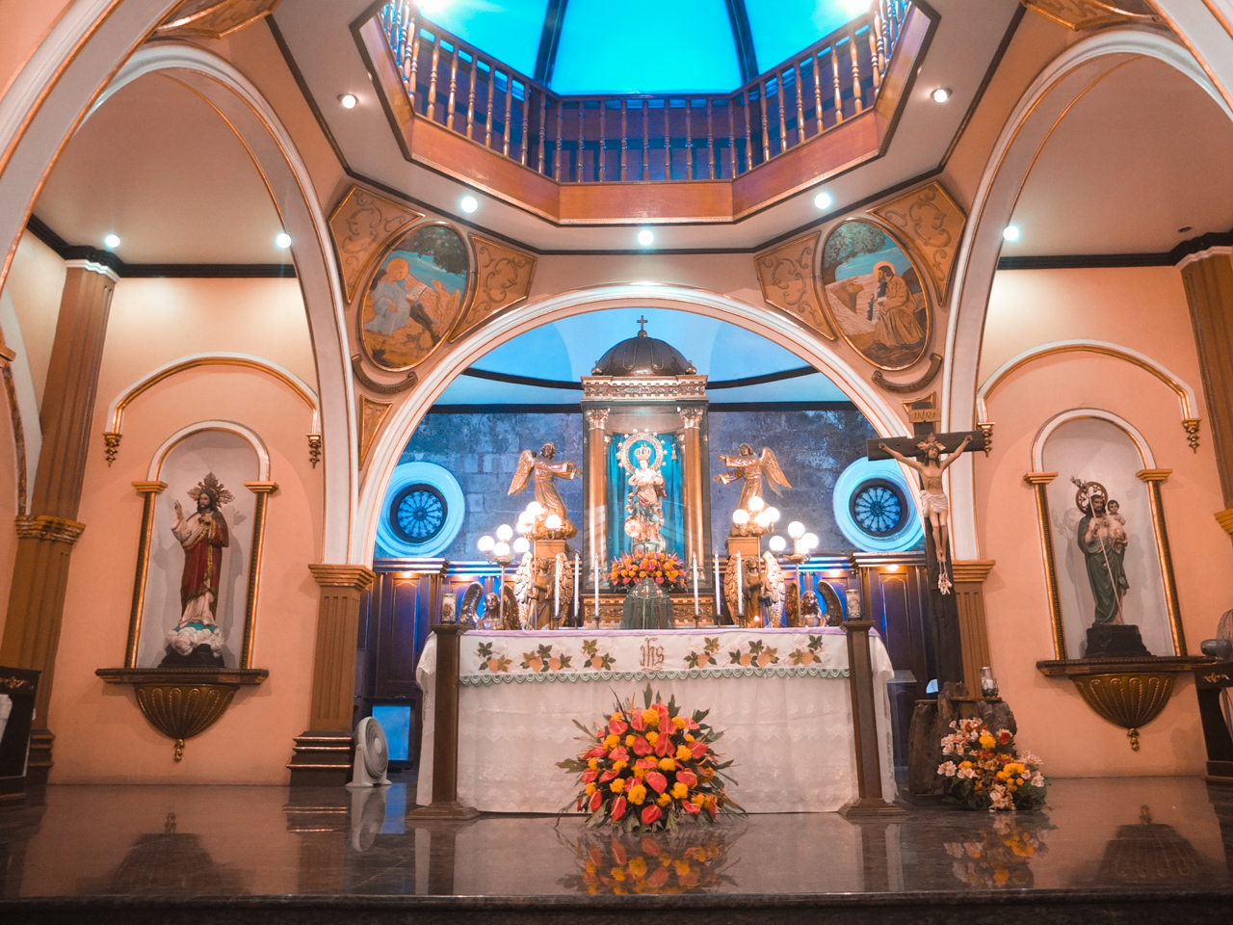

Immaculada Concepcion De Malabon Church was established by Augustine priests. It was made of rocks during the 1866 but has been destroyed by an earthquake in 1880. It has been used by the Iglesia Filipino Indipendiente as their church.
It is a small Church, but interiors are well kept and beautiful. The image of Immaculate Conception of this church is one of the few Marian images in the Philippines that is canonically crowned. This church is always an option for weddings because of it’s beautifully crafted design.

Slide 24
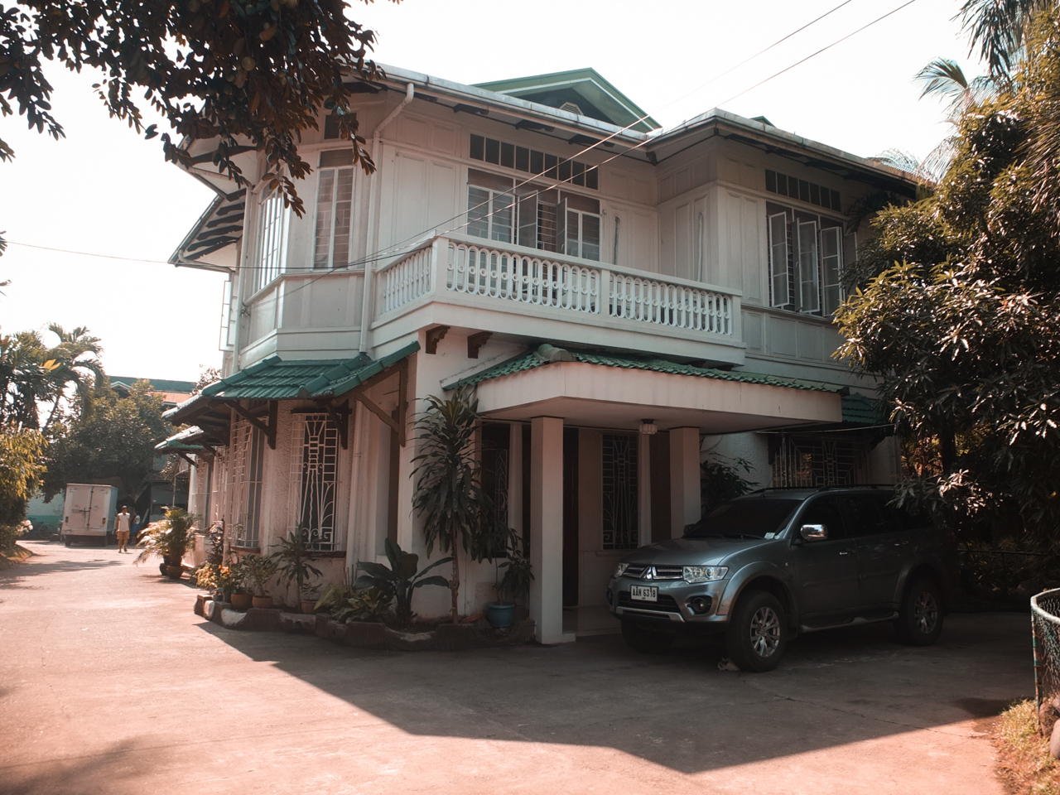
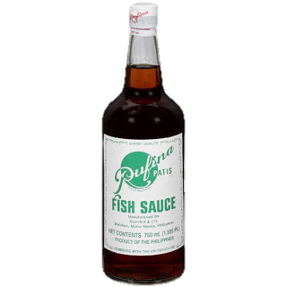
From its modest beginnings in the kitchen
of an enterprising housewife in 1900,
RUFINA PATIS has become a byword in homes and
restaurants over the years. As front runner
in the fish sauce industry in the Philippines,
it has continued to develop its product scientifically while maintaining rigid quality control. This dedication to quality has made RUFINA PATIS very popular not only locally but also in Europe, Canada, Hongkong, Australia, Middle East and the Mainland USA, where it it is currently being exported regularly. RUFINA PATIS has become an institution in itself. With its distinguished history going back to more than one hundred years, RUFINA PATIS has become an iconic home-grown product, and very much a part of Malabon's heritage that we can be proud of.

Slide 25
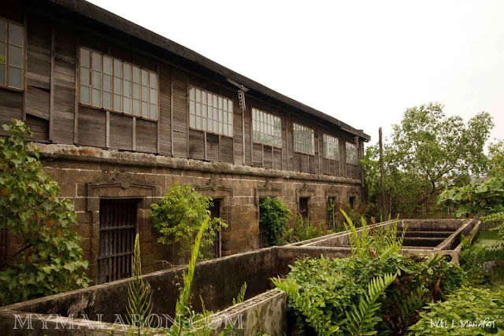
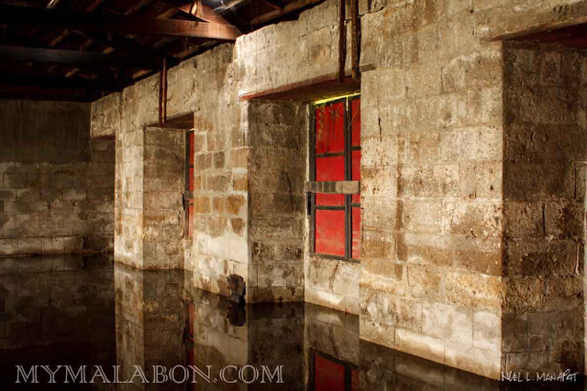
The place where the “La Independencia”, the organ of the Katipunan was printed. The place also served as orphanage for those who were affected by the plague of 1882.
These are apparently the vats where the raw leather was soaked in chemicals and dyes at the tannery. The ground floor is still made of the original adobe stone, while the second floor was already reconstructed.
According to Father Pedro Galende, the orphanage was provided with a printing press, lithography and binding room, spacious halls for shops and laboratories, sewing ans embroidery for girls, and a library. By 1893, the asilo housed 74 orphans and 11 persons in charge of the shops and 12 servants. All were attended by four religious.

Slide 26
The zoo is located along Gov. W. Pascual Street just behind the public schoolhouse, 30 yards away from the bustling commercial district in Monumento (Bonifacio Monument). From within its walls, one can hear the calls of raucous birds and animal cries resounding from deep within Barrio Potrero.
The idea of putting up a zoo in the heart of Malabon was inspired on how smog-filled and factory-ridden now industrial city was once a wilderness teeming with flora and fauna. Owner and visionary Manny Tongco realized that at the rate lands are being developed into commercial and residential areas, there would soon be no habitat left for animals except zoos.
While the mission of Malabon Zoo is to educate the Filipino children about wildlife so that they will be aware of its important role in their lives, thereby assuring the long-term security of the forest and the animals that live in it, Manny and his team of caretakers devote themselves educating the public, especially the young, on the importance of conserving wildlife.

Slide 27
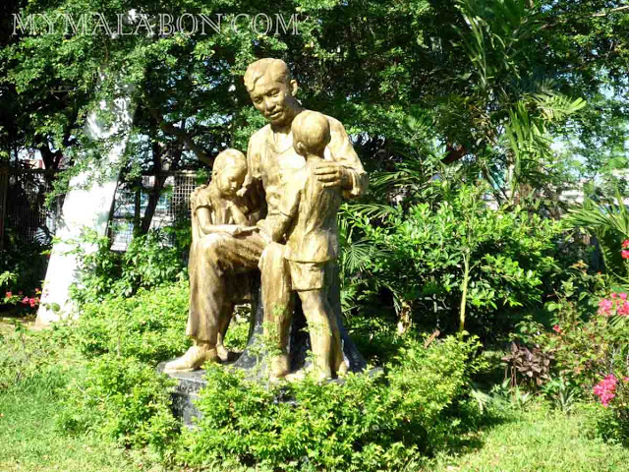
The monument was from an effigy designed by National Artist Guillermo Tolentino. The arc and pedestal were done by Engr. Angel Lazaro, Jr. and the statue was carved by Federico Alfato.
The arc or parabola makes this monument unique and serves as an excellent frame for the statue.
The monument was put up through the efforts of the Knights of Rizal, whose members made the rounds of prominent people in Malabon and Navotas in order to raise funds. According to Angeles Santos in his book "Ang Malabon," during their rounds, a foreigner offered to pay for the entire cost of the monument as long as the marker would indicate that he alone paid for it. The committee did not accept his offer as it was inappropriate that a foreigner should pay for Rizal's monument.

Slide 28

Pancit is as crucial to each Filipino feast as rice is to every complete Filipino meal. With Santacruzan (among other regional fiestas all over the country) looming over the month of May, stuffing one’s face with numerous variations of the said noodle dish is a delightful certainty. Yet while preparing (and consuming) big cauldrons of pancit is second nature to any true-blue Pinoy, the origins of this iconic party food are not exactly confined to a specific region (or to our country, for that matter).
Pancit luglog also referred to in some circles as Pancit Malabon, this dish uses thick rice noodles that are dunked in hot water to soften them prior to adding the lip-smacking, unctuous orange sauce (“Luglog” means “to dunk in water”). Littered with fresh shrimp, squid, and even shucked oysters fresh off the northern fishing town of Malabon, this pancit is legendary and is a known staple in office and classroom parties alike

Slide 29
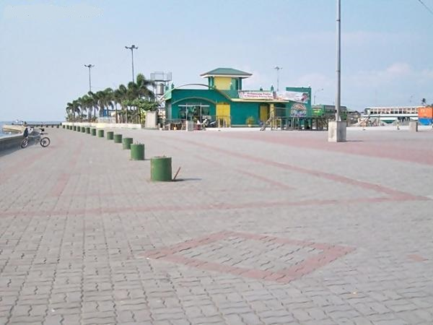
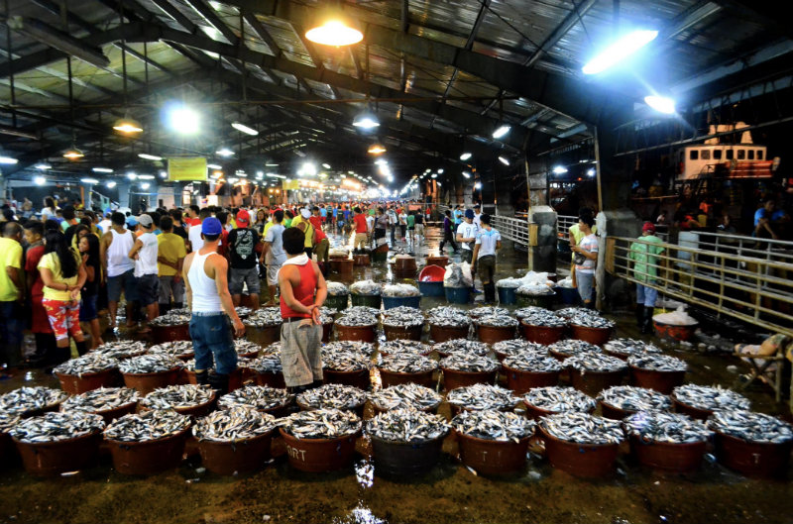
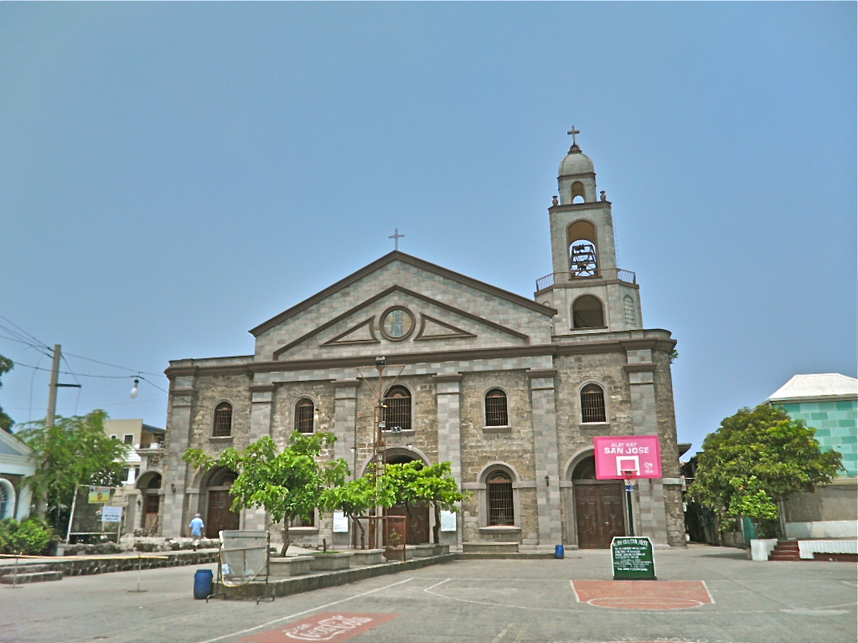
Navotas Centennial Park
Navotas Fish Port
San Jose Parish Chruch
V I S I T
V I S I T
V I S I T

Slide 30
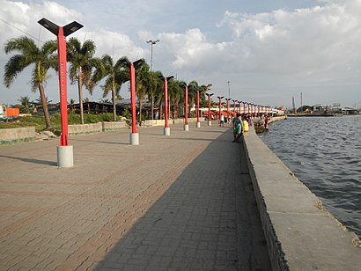
The park was opened on January 16, 2006 during the celebration of the 100th Founding Anniversary of the municipality of Navotas, it was built on the site of a former garbage transfer station during the term of Mayor Toby Tiangco who described the project as "garbage turned into gold."The park hosts a variety of activities and local government celebrations throughout the year, including the annual Pangisdaan Festival commemorating the founding anniversary of the "Fishing Capital of the Philippines", and the Bangkang de Sagwan race launched by Mayor John Rey Tiangco in January 2017
The Navotas Centennial Park is a waterfront park in Navotas, Metro Manila, the Philippines, facing the Manila Bay. It is the largest open space in the city and is CAMANAVA or North Manila District's version of the Baywalk.
Navotas Centennial Park

Slide 31
Navotas Fish
Port Complex
The Navotas Fish Port Complex (NFPC), the premier fish center of the Philippines and one of the largest in Asia, is the first major fishing port and fish market complex placed under the jurisdiction, control and supervision of the Philippine Fisheries Development Authority (PFDA). It is a traditional landing place of commercial fishing boats operating in various fishing grounds in the Philippines. The construction of the Port Complex spanned three years from August 1973 to August 1976 through a Php 88 Million loan from the Asean Development Bank (ADB). It supplies fish and other aquatic products to major markets in Metro Manila.

Slide 32
AFTER SAN JOSE DE NAVOTAS PARISH was canonically erected on July 1, 1859, the construction of a provisional parish church started in November of the same year. It was in 1860, under the helm of Rev. Fr. Matias Naboa that the main altar was completed, the cemetery was inaugurated, and the belfry was erected. Right from the start, the parish boasted of a spacious churchyard.
Although the earthquake of June 1863 partially demolished the rectory, it was immediately reconstructed months after, through Fr. Naboa’s initiatives. Several improvements have been made since then, such as the construction of a complete, new parish complex, still under Fr. Naboa, and the baptistery, under the supervision of Rev. Fr. Manuel Perez. But, as another earthquake (1880) jolted the parish rectory, the parish priest, Rev Fr. Marcos Hernandez was forced to stay at the house of Capitan Juan Sioson, situated in front of the church. On June 1892, Rev. Fr. Tomas Agudo led the construction of the present–day parish, with the altar done by April 1895.
San Jose Parish Chruch
The Parish of San Jose de Navotas withstood other endeavors sturdily, from Aglipayan Schisms of the early 1900’s, the storm of October 16, 1934 that substantially damaged the church, to the invasion of Japanese armies and the aftermath of the battles. These scars give justice to the will of the people of Navotas; ever–dedicated, ever–faithful.

Slide 33




Shoe Museum
Marikina River Park
V I S I T
V I S I T
Diosesan Shrine
V I S I T
V I S I T

Slide 34

It is the most awarded river in the Hall of Fame awardees for the Cleanest Inland Body of Water in the Philippines. Marikina River Park is a popular camping site, picnic grounds and recreational park, such as concrete jogging and bike lanes, benches and skating rink.
At night, Marikina River Park transforms into a modern nightlife events center because of numerous bars, restaurants, cafés and night clubs along the riverbanks. Other attractions in Marikina River include the Roman Garden, Chinese Pagoda, Kawayanan, Youth Camp, Animal Trail, Skating Rink and Women's Park. It is also a traditional venue for the Marikina Christmas Festival which begins annually as early as October.
The Marikina River Park is the “biggest sports and recreational park in the country in a natural setting”. It is located in Marikina City and runs alongside a portion of the 27 km Pasig-Marikina River, which is the main river system in Eastern Metro Manila. The Marikina River Park has the distinction of being the cleanest inland body of water in the Philippines.
During the Holiday Season, it is the venue for the city’s annual Christmas Festival. It is also the site for the Mama Mary Fluvial Parade.

Slide 35
The Shoe Museum was conceived of in 1998, on the assumption that the town was the then Shoe Capital of the Philippines, by the then mayor, Bayani F. Fernando. The museum was then officially opened in 2001 and was known as the Footwear Museum of Marikina. Its purpose was to nurture the historical and cultural value of the Philippines’ shoe industry. The building where the museum is located is a historical landmark since it happened to be a detention cell for the Filipinos during the Filipino-American war.
The museum has collections that feature the footwear of former first lady, Imelda Marcos, as well as shoes owned by presidents, vice presidents, mayors, senators and many other heads of the Philippine government. The museum holds shoes made in many different designs and with different materials, such as those made of snake skin, pigskin, sheepskin and much more. I definitely recommend a tour of this museum, while in Marikina city.
Shoe Museum

Slide 36
Philippine Science Centrum (PSC) is a premier hands-on science center museum in the country recognized by the Department of Education, Department of Science and Technology and the Department of Tourism as an ideal venue for educational field trip destination where visitors are encouraged to touch, twist, play, hear, see the interactive exhibits displayed. PSC is open to pre-school to college students, families and the general public.
PSC showcases over hundred hands-on exhibits in eleven (11) exciting galleries (Lights, Bodyworks, Mathematics, Electricity & Magnetism, Water, Vision and Perception, Infectious Diseases, Earth Science, Space, Kids’ World and Mechanics) and various educational activities, outreach programs and trainings complementing the Department of Education ‘s K to 12 education curriculum and its goal of upgrading the level of science education in the country.

Slide 37
Also known as OLA Church, this Spanish-era church is located along J. P. Rizal Street in Santa Elena. The church was started by the Augustinians in 1687 and was finished in 1690. On October 21, 1791, the whole parish was consecrated under the Marian title, Nuestra Sra. Delos Desamparados (Our Lady of the Abandoned), the second oldest parish in the Philippines after that of Sta. Ana in Manila under that title This place of worship was destroyed by earthquakes and by fires in the 19th century. It has undergone a series of renovations since 1963. The church houses the miraculous image of the religious patron of Marikina City, Our Lady of the Abandoned (OLA), which was canonically crowned last October 15, 2005 by virtue of Pope Benedict XVI, the first under his papacy. Leading the coronation rites was His Eminence, Gaudencio Cardinal Rosales of the Archdiocese of Manila. On August 5, 2007, the church was elevated into a diocesan shrine by the Most Rev. Gabriel V. Reyes, D.D., Bishop of Antipolo. Also in 2007, the parish was made the residence of the new auxiliary bishop of the Diocese of Antipolo, Most Rev. Francisco M. de Leon, D.D. who serves as its parish priest. The shrine has now become a center of pilgrimage not only for Marikina residents but also from devotees of Our Lady of the Abandoned from Metro Manila and other neighboring provinces.

Slide 38



GreenHills Shopping Center
Pinaglaban Memorial Shrine
Club Filipino
V I S I T
V I S I T
V I S I T

Slide 39

Greenhills Shopping Center is a shopping centre in the city of San Juan with over 2,000 stores, and espouses an 'indoor-outdoor' theme. The Shopping Center have the appearance of several distinct buildings (some separated by a main road) that are all interconnected through pathways and bridges and hosts a Roman Catholic chapel and a Muslim prayer room.
Greenhills began in the early 1960s. Plans were drawn up to create a fully complemented first class residential community to include schools, churches and what was then the most modern concept for a shopping centre as its centerpiece.
Plans for building the Greenhills Shopping Centre began in 1966 following two years of studying some of the world’s most advanced community development projects. The proposed concept for the Greenhills Shopping Center, modern in every aspect and suited to local conditions, was presented by Architect Juan Nakpil. The concept included a supermarket, a movie house, variety stores, a bowling alley, service shops and restaurants.

Slide 40

A historical site where Andres Bonifacio headed the first battle of the Philippine Revolution against the Spanish Regime on August 30, 1896.
The underground is known as El Deposito, used to be the water reservoir serving the entire Greater Manila area.

Slide 41
An exclusive club of historical value because it was here where President Corazon C. Aquino was sworn in as President of the Republic of the Philippines by the late Chief Justice Claudio Teehankee after the famous EDSA Revolution in 1986.
Then there is the Club Filipino, one of the oldest clubs in existence in the country. It is also perhaps one of the most popular social clubs in the country, particularly due to the role it has played in the country’s history.

Slide 42






Quiapo Church
Manila Ocean Park
National Museum
V I S I T
V I S I T
V I S I T
Fort Santiago
Divisoria Market
Rizal Park
V I S I T
V I S I T
V I S I T
Fort Santiago

Slide 43

Manila Ocean Park
Fort Santiago
National Museum of the Philippines
Divisoria Market

Slide 44












SM MEGAMALL
Shangri – La Plaza
SM MEGAMALL
V I S I T
V I S I T
Dambana ng mga Alaala
Trampoline Park
V I S I T
V I S I T

Slide 45







Ace Water Spa
Rain Forest Park
Ortigas Center
V I S I T
V I S I T
V I S I T
Fun Ranch
Ark Avilon Zoo
V I S I T
V I S I T

Slide 46




Slide 47






Ayala Museum
Salcedo Market
Greenbelt Park
V I S I T
V I S I T
V I S I T
Nuestra Señora de Gracia Church
B-Side
Mind Museum
V I S I T
V I S I T
V I S I T

Slide 48


Slide 49






Mall of Asia
Desert Museum
Airforce Aerospace Museum
V I S I T
V I S I T
V I S I T
Okada
Dream Play
V I S I T
V I S I T
V I S I T

Slide 50



Salt Industry
Sarao Jeepney Factory
Historical Corridor
V I S I T
V I S I T
V I S I T

Slide 51




Bonifacio Global City
Venice Grand Canal
Mercado Del Lagro
Libingan ng mga Bayani
V I S I T
V I S I T
V I S I T
V I S I T

Slide 52




Bird Sanctuary
DAMPA
Baclaran Church
Solaire
V I S I T
V I S I T
V I S I T
V I S I T

Slide 53



Jamboree Lake
Alabang Town Center
Bellevue Manila
V I S I T
V I S I T
V I S I T

